Slide 1

Guidelines for
Accessible PPTs
Accessible and Inclusive Learning
Prof. Konstantinos Priftis
Department of General Psychology
(January 28, 2019)

Slide 2
Guidelines
For the creation
of Power Point Presentations,
for Audiences that may Include
Persons with Low Vision
Design for ALL = Include ALL

Slide 3
What Does Accessibility of Power Point Presentations Mean?
…it means that everyone, including the people with visual disabilities can read and enjoy the content of the slides.

Slide 4
Accessibility of PPT
We can design or adapt an existing presentation, using some essential guidelines to help anyone use and enjoy the PowerPoint presentation.

Slide 5
Accessibility of PPT
In this tutorial, we'll talk and learn about how we can develop or convert an existing PowerPoint presentation into an accessible format, in such a way that:
- The content becomes readable/accessible to ALL
- The presentations can be easily converted into alternative print formats and retain readability.

Slide 6

We are going to talk about …
The UNIVERSAL DESIGN
in Power Point presentations

Slide 7
14 Important Points !
To create an Accessible PPT
Background color
Font types
Titles and headings size
Font size of text
Italic
Use of colors for text
Align text left

Slide 8
14 Important Points !
(Continue)
8. Simple slides. Amount of information.
9. Figures, graphs, etc.
10. Shadows and Shades of gray (avoid)
11. Pictures and corrections
12. Grayscale (avoid) and color
13. Color accessibility for Color Blindness
14. Acceptable animations features

Slide 9
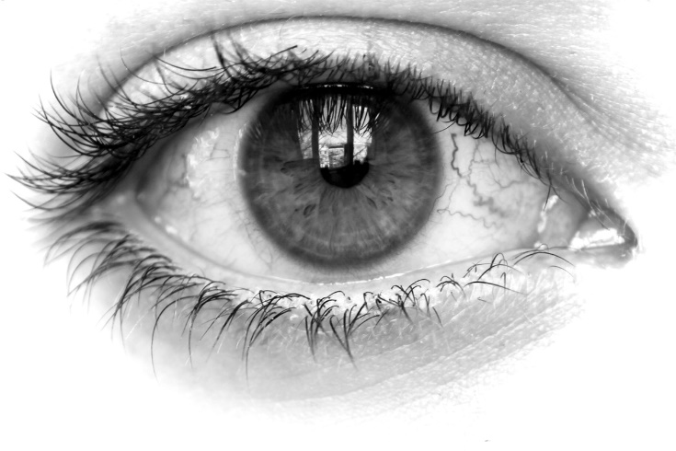
When you design the presentation for audiences that may include people with low vision, put yourself in their shoes by….

Slide 10

Viewing the lecture screen from 50 meters away…
Or viewing the screen through a blurred window…

Slide 11
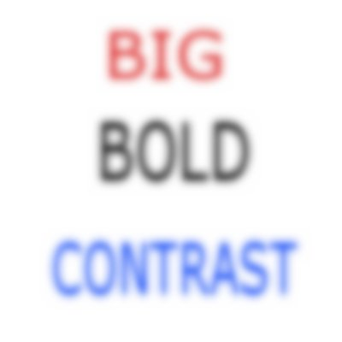

Slide 12
We can make choices/adjustments that will:
Provide excellent contrast
Be large enough
Be friendly to people with visual impairments and/or color blindness
Be comfortable to the reader

Slide 13
1. Backgrounds
Background and Text should be of high contrast.
Background should be simple, not graphical, and should be one color.
Therefore, we use
black letters on
white background

Slide 14
1. Backgrounds (continued I)
An off white, cream background is also allowed when we have to use a different background.
The letters of the text should be black.

Slide 15
1. Backrounds (continued II)
Two color gradients are acceptable where one is white and the other is pastel.

Slide 16
One more info….
About blue
Blue, should be avoided as α background color for the slides.
Blue makes the eyes work 2 trillion times harder per second than red, pink, orange or yellow.

Slide 17
Which is more comfortable to look at?
This?

Slide 18
This?
☺

Slide 19
Or Perhaps This?
☺

Slide 20
2. Font Type
Use Sans serif font types such as Verdana, Arial o Tahoma which are simple and easily recognizable characters.

Slide 21
2. Font Type (continued)
Remember that different types with the same ‘point size’ have different appearing sizes.
(e.g. Calibri < Arial < Verdana)
Verdana offers optimal readability therefor it is advisable.

Slide 22
Difficult Font types to read
Font types with serifs such as
‘Times New Roman’ or
‘Garamond’,
for low vision people are difficult to read.
Avoid complicated, decorative fonts:
AVOID ME!!!

Slide 23
3. Titles and headings
Should be larger than the text of the document:
Use size 40-44 where is possible

Slide 24
4. Font size of text
Use 32 – 38 where is possible
(minimum point size for letters:
28 – 30pt.).
Bold letters/text is more visible.
Smaller size for web pages
(e.g. 20 pt. or larger)

Slide 25
5. Italic font style
Italics should be avoided IF POSSIBLE.
“Italics” style (for low vision people) are very difficult to read.

Slide 26
What can we use instead of Italics?
Better Choices: bold the quotation or underlining, or use a different color (e.g. dark brown or blue, purple) instead of Italics.
“Enclosing in quotation marks”

Slide 27
Example
We are born capable of learning.
—JEAN-JACQUES ROUSSEAU
Swiss-Born French Philosopher, 18th Century

Slide 28
Example
"We are born capable of learning".
—JEAN-JACQUES ROUSSEAU
Swiss-Born French Philosopher, 18th Century

Slide 29
6. Use of colors for text
Red/green and blue/yellow combinations should be avoided. http://www.color-blindness.com/coblis-color-blindness-simulator/
Better choices are
- dark purple or
- dark brown or dark blue

Slide 30
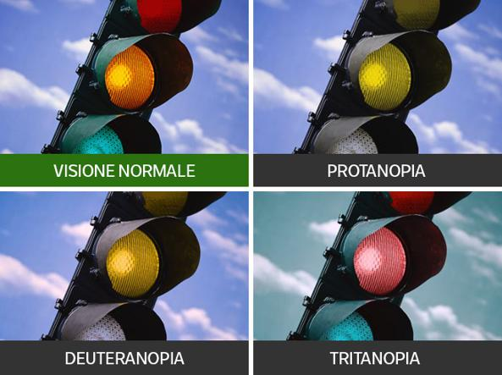

Slide 31
Text and background should be of high contrast.
If the text is dark, the background should be light.
If the text is light, the background should be dark.

Slide 32
Some good text/background
color combinations are:
Dark green and white
Dark red and white
Yellow and violet
Violet and white
Dark blue and yellow
Black and white
Black and yellow
Pink and black
Dark blue and white

Slide 33
Because they provide poor contrast,
certain colors should not be used together
either as graphic features, background or text:
Red and green
Blue and black
Green and black
Violet and black
Dark blue and violet
Red and black
Two values of the same color

Slide 34
7. Align text left
Display the text in blocked paragraphs which are aligned left. Do not “justify” text.
Correct
Display the text in blocked paragraphs which are aligned left. Do not Not “justify” text.

Slide 35
Also……
Avoid divided words at the ends of lines
We seek to enhance the student expe- rience by creating a learning and tea- ching environment, and culture, that is dynamic, accessible and inclusive. What we do to make our presentation access- ible for the persons with low vision will ultimately make it more readable for everyone.

Slide 36
Also……
Avoid divided words at the ends of lines
We seek to enhance the student experience by creating a learning and teaching environment, and culture, that is dynamic, accessible and inclusive. What we do to make our presentation accessible for the persons with low vision will ultimately make it more readable for everyone.

Slide 37
8. Simple slides
Simple slides are much more readable.
With no more than 3 different blocks of information
Nor more than 6-7 individual lines of information per block, if possible.
It is not advisable to use more than six bulleted lines

Slide 38
8. Simple slides (continued)
If we have a “heavy” slide with long text, which cannot be properly modified…. We can create 2 or more slides: keep the title and split the content into 2 or more slides.
Attention: see the TITLE marked with “continued”

Slide 39
Example
Adapt slide and text format to meet the needs of visually impaired readers

Slide 40
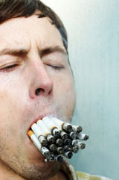
Attitudes
Two types of attitudes
  Reasoned attitudes
  Automatic evaluations
Attitude change
  Central route
  Peripheral route
Attitudes influence behavior:
  Attitude measurement
  Attitude strength
  Motivation and ability for information processing
Behavior influences attitudes:
  Self-perception: ‘cold’ cognitive process
  Dissonance: ‘hot’ motivational process
  Attitude strength

Slide 41
Attitudes
Two types of attitudes
  Reasoned attitudes
  Automatic evaluations
Attitude change
  Central route
  Peripheral route

Slide 42
Attidutes (continued I)
Attitudes influence behavior:
  Attitude measurement
  Attitude strength
  Motivation and ability for information processing

Slide 43
Attidutes (continued II)
Behavior influences attitudes:
  Self-perception: ‘cold’ cognitive process
  Dissonance: ‘hot’ motivational process
  Attitude strength

Slide 44
Another Example

Slide 45
EXECUTIVE FUNCTIONS
Lezak defined executive functions as ‘‘those capacities that enable a person to engage successfully in independent, purposive, self-serving behavior’’ (Lezak, 1995, p. 42); executive functions consists of planning, purposive action, self-monitoring, self-regulation, and volition. Other terms commonly used include inhibition and flexibility.
Lezak again:
The executive functions comprise those mental capacities necessary for formulating goals, planning how to achieve them, and carrying out the plans effectively. They are at the heart of all socially useful, personally enhancing, constructive, and creative activities.

Slide 46
EXECUTIVE FUNCTIONS
Lezak defined executive functions as ‘‘those capacities that enable a person to engage successfully in independent, purposive, self-serving behavior’’ (Lezak, 1995, p. 42); executive functions consists of planning, purposive action, self-monitoring, self-regulation, and volition. Other terms commonly used include inhibition and flexibility.

Slide 47
EXECUTIVE FUNCTIONS (continued)
Lezak again:
The executive functions comprise those mental capacities necessary for formulating goals, planning how to achieve them, and carrying out the plans effectively. They are at the heart of all socially useful, personally enhancing, constructive, and creative activities.

Slide 48
9. Figures and graphs
Figures and graphs should be as simple as possible.
Print across the illustrations should be avoided.

Slide 49
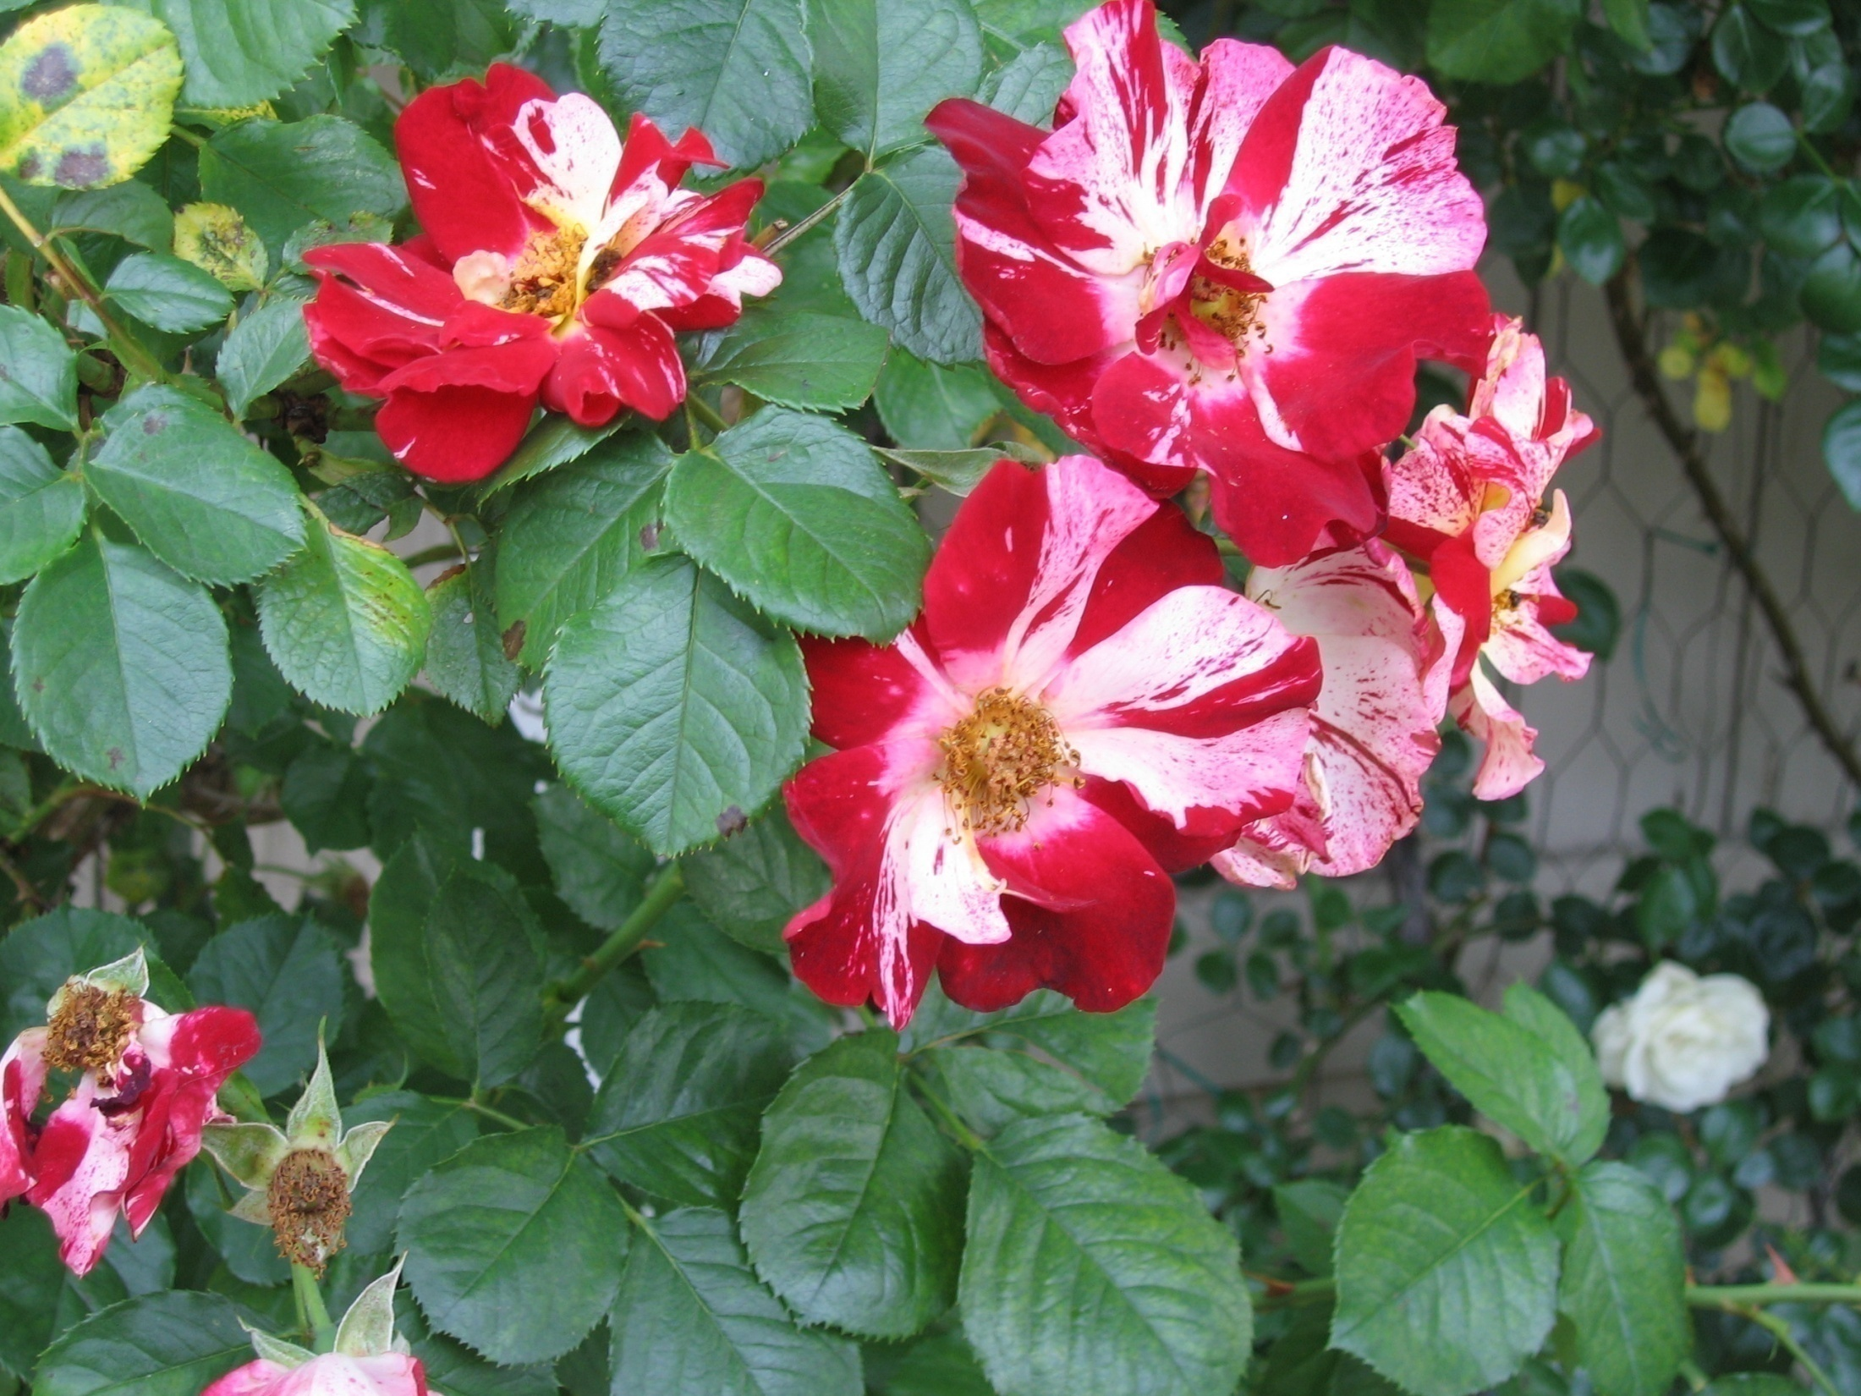
Complex or graphic backgrounds make text
Difficult to read. Keep backgrounds simple
so text will be visible.

Slide 50
How does early and late maturation inﬂuence adolescent development?

Slide 51
How does early and late maturation inﬂuence adolescent development?

Slide 52
About illustrations
Remember that:
Readers with low vision have trouble with maps, diagrams, forms, tables, flow-charts, maps, etc.
Illustrations could be isolated and presented with strong contrast and in a larger scale. Use good quality, not faded.

Slide 53
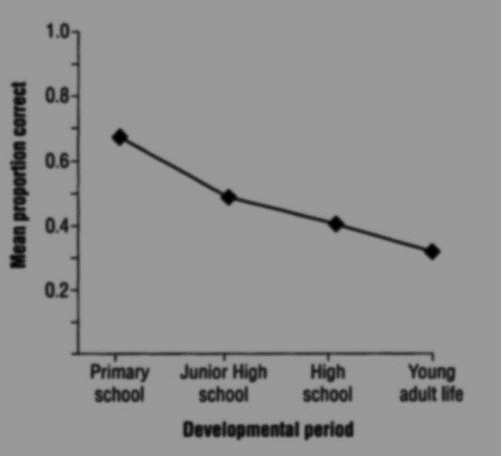
Ribot’s law: retrograde amnesia gradient

Slide 54
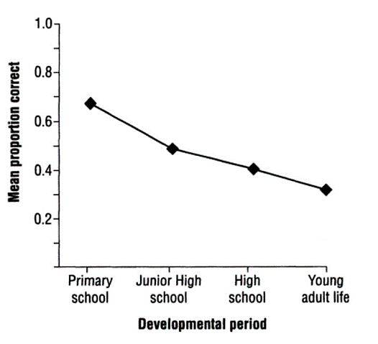
Ribot’s law: retrograde amnesia gradient
Mean proportion correct

Slide 55
10. Shadows and hades of gray
In Text…
Shadowed text changes the shape of letters and makes the text less readable

Slide 56
10. Shadows and shades of gray (continued)
Shadowed text and shades of gray limits the contrast between the letters and the background.
ELIMINATE Shadows
ELLIMINATE Shades of gray

Slide 57
Gray should be avoided in both text and background
Gray should be avoided in both text and background

Slide 58
Shades of gray should not be used together
either as graphic features, background or text
Shades of gray should not be used together either as
graphic features, background or text because there is almost no contrast

Slide 59
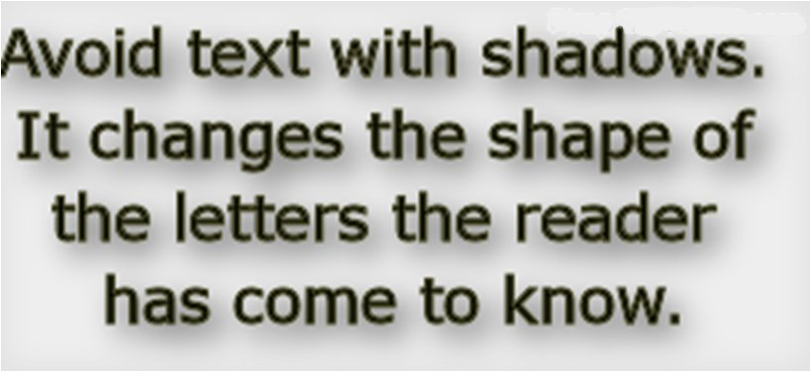
Shadowed text also limits the contrast
between the letters and the background.

Slide 60
Shades of gray should not be used together, either as graphic features, background or text
Remember: Background and Text should be of high contrast.

Slide 61
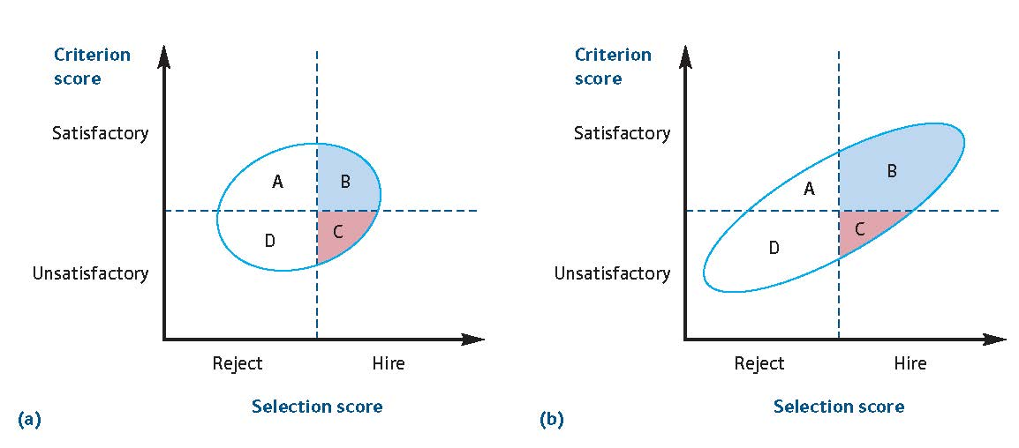
11. Pictures and corrections
Improve the contrast, brightness, sharpness of pictures and present them in a larger scale. (edit text if it is necessary)

Slide 63
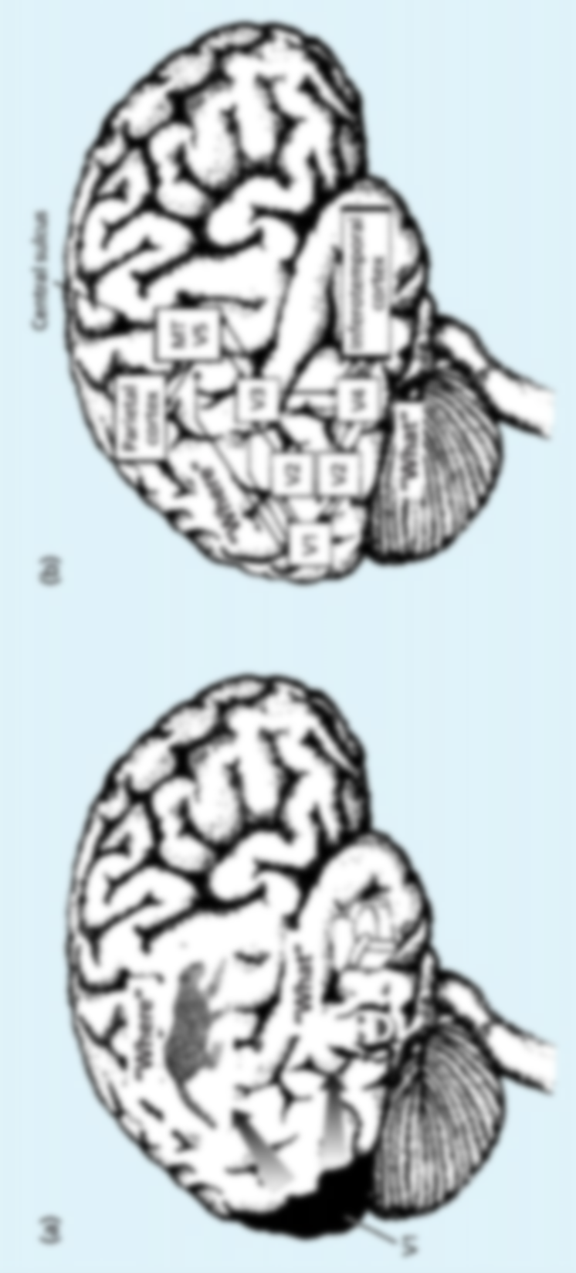
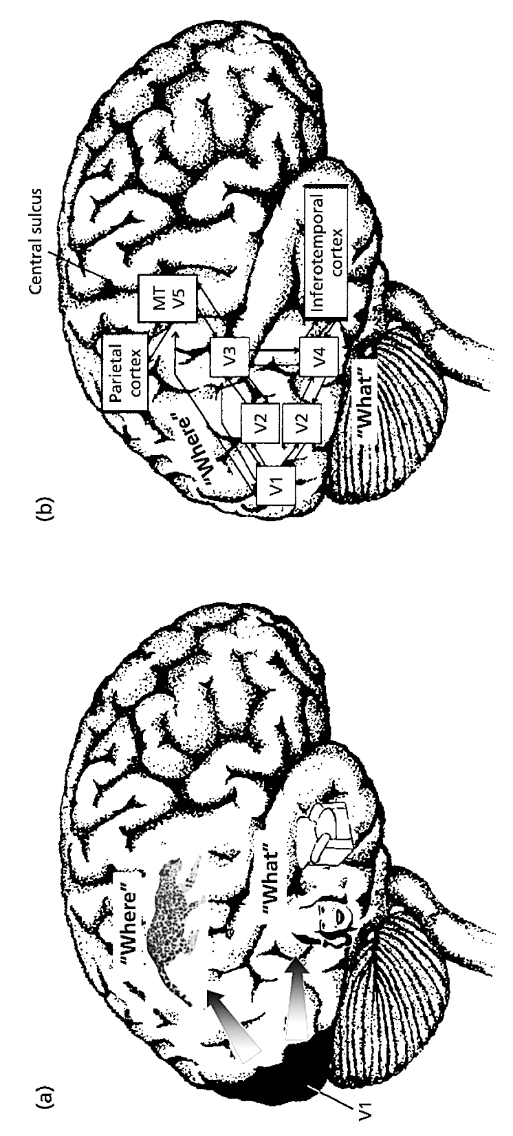
11 Pictures and corrections
(continued)

Slide 64
Grayscale
Grayscale is not a good option for:
photos
graphics
graphs
Maps, charts, etc.
It should be avoided, if possible, because it does not provide good contrast.

Slide 65
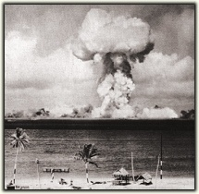

Here is why Grayscale is not
useful for persons with low vision
Grayscale

Slide 66
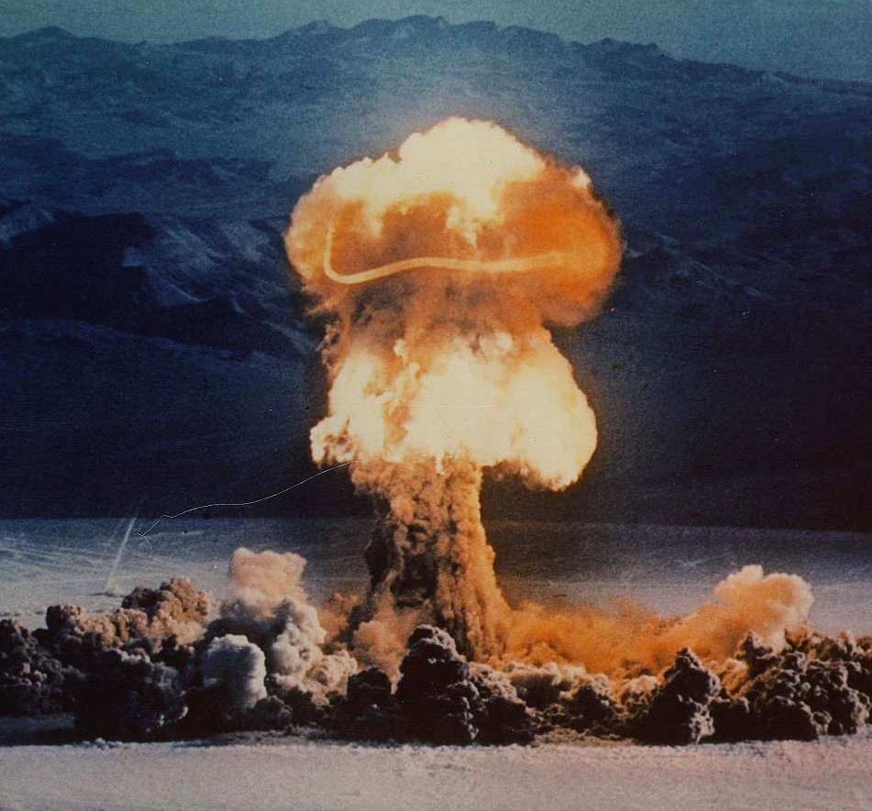
Color provides much better contrast
https://www.aph.org/accessible-media-guidelines/

Slide 67
13. Color accessibility for Color Blindness
Few color combinations to avoid:
  Green & Red
  Green & Brown
  Blue & Purple
  Green & Blue
  Blue & Yellow
  Blue & Grey
  Green & Grey
  Green & Black

Slide 68
14. ANIMATION FEATURES
Avoid animations and sounds if not crucial to content of presentation.
Animations may cause screen readers to read the slide twice.
Animations may cause further eye strain and reading difficulties.

Slide 69
14. ANIMATION FEATURES (continued)
If animations are necessary to the content, the following might be more acceptable:
Wipe right
Fly in from left
Typewriter
Appear

Slide 70
References (main sources)
American Printing House for the Blind. Power point presentation, developed by Elaine Kitchel, M.Ed. Low Vision Project Leader, available at https://www.aph.org/accessible-media-guidelines/
Best Practices and Guidelines for Large Print Documents used by the Low Vision Community authored by the Council of Citizens with Low Vision International available at
http://www.acb.org/large-print-guidelines

Slide 71
Further guidance/ useful link for technical matters
The WebAIM (Web Accessibility In Mind) organisation has a technical guide to creating accessible PowerPoint presentations. Available at:
https://webaim.org/techniques/powerpoint/

Slide 72
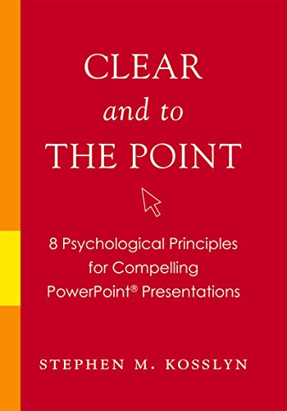

Slide 73

Let’s see together
some examples
Good and less good practices

Slide 74
Let’s keep in mind that:
Designing for accessibility doesn’t mean that the aesthetic integrity of our design needs to suffer.
There are many ways to obtain an accessible presentation and an excellent result in terms of aesthetic.

Slide 75
INFANT DEPTH PERCEPTION
At what age are infants able to use different kinds of depth information?
The answer to this question is that different types of information become operative at different times.
Binocular disparity becomes functional early, and pictorial depth cues become functional later.
FOXE’S EXPERIMENT:
an infant wearing special viewing glasses was seated in his mother’s lap in front of a television screen

Slide 76
INFANT DEPTH PERCEPTION
At what age are infants able to use different kinds of depth information?
The answer to this question is that different types of information become operative at different times.
Binocular disparity becomes functional early, and pictorial depth cues become functional later.
FOXE’S EXPERIMENT:
An infant wearing special viewing glasses was seated in his mother’s lap in front of a television screen

Slide 77





Phonemic analysis
Graphemic analysis
Phonological input lexicon
Orthographic input lexicon
Semantic memory
Phonological output lexicon
Orthographic output lexicon
Phonemic output buffer
Graphemic output buffer
Phonological agraphia (inability to write non words)

Slide 78
Some corrections to obtain a better result/accessible could be….
Improve the CONTRAST
Enlarge the font size of the text in the cells (24-28 pt. instead of 18 which was on the initial slide)

Slide 79
Phonemic analysis
Graphemic analysis
Phonological input lexicon
Orthographic input lexicon
Semantic memory
Phonological output lexicon
Orthographic output lexicon
Phonemic output buffer
Graphemic output buffer
Phonological agraphia (inability to write non words)

Slide 80
Another example…
Eliminate shadow from the title and change color
Improve the CONTRAST
Enlarged the font size of the text

Slide 81


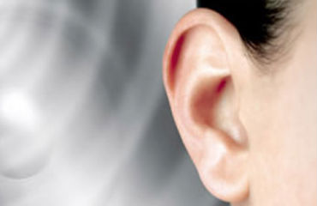

Wernicke-Lichtheim’s model
Semantic memory
Visual word representations
Articulatory word representations
Auditory word representations
Graphomotor word representations
Hemiparesis/
hemiplegia

Slide 82
Wernicke-Lichtheim’s model
Semantic memory
Visual word representations
Articulatory word representations
Auditory word representations
Graphomotor word representations
Hemiparesis/
hemiplegia

Slide 83
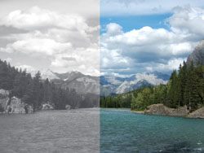
CORTICAL ACHROMATOPSIA
LESION SITE: AREA V4
Definition: acquired neuropsychological deficit of color vision
Bilateral lesions of V4 affect the whole visual field
Unilateral lesions of V4 affect only the contralesional visual hemifield

Slide 84
CORTICAL ACHROMATOPSIA
LESION SITE: AREA V4
Definition: acquired neuropsychological deficit of color vision
Bilateral lesions of V4 affect the whole visual field
Unilateral lesions of V4 affect only the contralesional visual hemifield

Slide 85
social group memberships
Identities
roles
traits and characteristics
social relations

Slide 86
Social group memberships
Roles
Identities
Social relations
Traits and characteristics

Slide 87
Splitting the text of 1 slide into 2 or more slides…
Try to keep the image in both slides in order to keep the relation between them.
It is easier to understand that the slides are connected / related.
EXAMPLE of a “heavy” slide

Slide 88
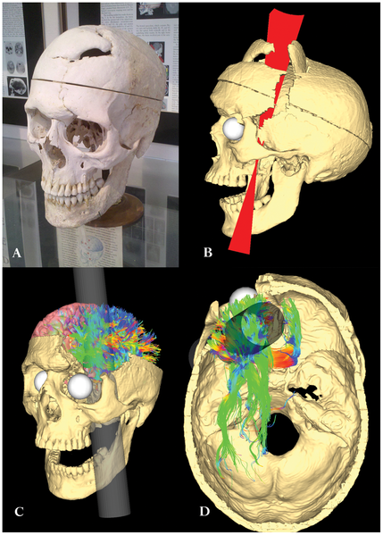
Harlow described Gage’s changes:
“His contractors, who regarded him as the most efficient and capable foreman in their employ previous to his injury, considered the change in his mind so marked that they could not give him his place again. He is fitful, irreverent, indulging at times in the grossest profanity (which was not previously his custom), manifesting but little deference for his fellows, impatient of restraint of advice when it conflicts with his desires, at times pertinaciously abstinent, yet capricious and vacillating, devising many plans of future operation, which are no sooner arranged than they are abandoned in turn for others appearing more feasible. In this regard, his mind was radically changed, so decidedly that his friends and acquaintances said he was "no longer Gage".

Slide 89
Harlow described Gage’s changes:
“His contractors, who regarded him as the most efficient and capable foreman in their employ previous to his injury, considered the change in his mind so marked that they could not give him his place again…”

Slide 90
Harlow described Gage’s changes:
(continued I)
“…He is fitful, irreverent, indulging at times in the grossest profanity (which was not previously his custom), manifesting but little deference for his fellows, impatient of restraint of advice when it conflicts with his desires, at times pertinaciously abstinent, yet capricious and vacillating, devising many plans of future operation, which are no sooner arranged than they are abandoned in turn for others appearing more feasible….”

Slide 91
Harlow described Gage’s changes:
(continued II)
“…In this regard, his mind was radically changed, so decidedly that his friends and acquaintances said he was "no longer Gage“.

Slide 92
more examples/solutions…

Slide 93
Arithmetic mean ( )
centre of gravity of distribution (scores as cubes on a balance scale)
e.g., {6, 8, 3, 4, 8}
    (6 + 8 + 3 + 4 + 8) / 5 = 5.8
    in general:
1
2
3
1
2
3

Slide 94
Arithmetic mean ( )
centre of gravity of distribution (scores as cubes on a balance scale)
e.g., {6, 8, 3, 4, 8}
    (6 + 8 + 3 + 4 + 8) / 5 = 5.8
    in general:
1
2
3
1
2
3

Slide 95
More examples/solutions…
Redesign a table to obtain an accessible slide ….

Slide 96
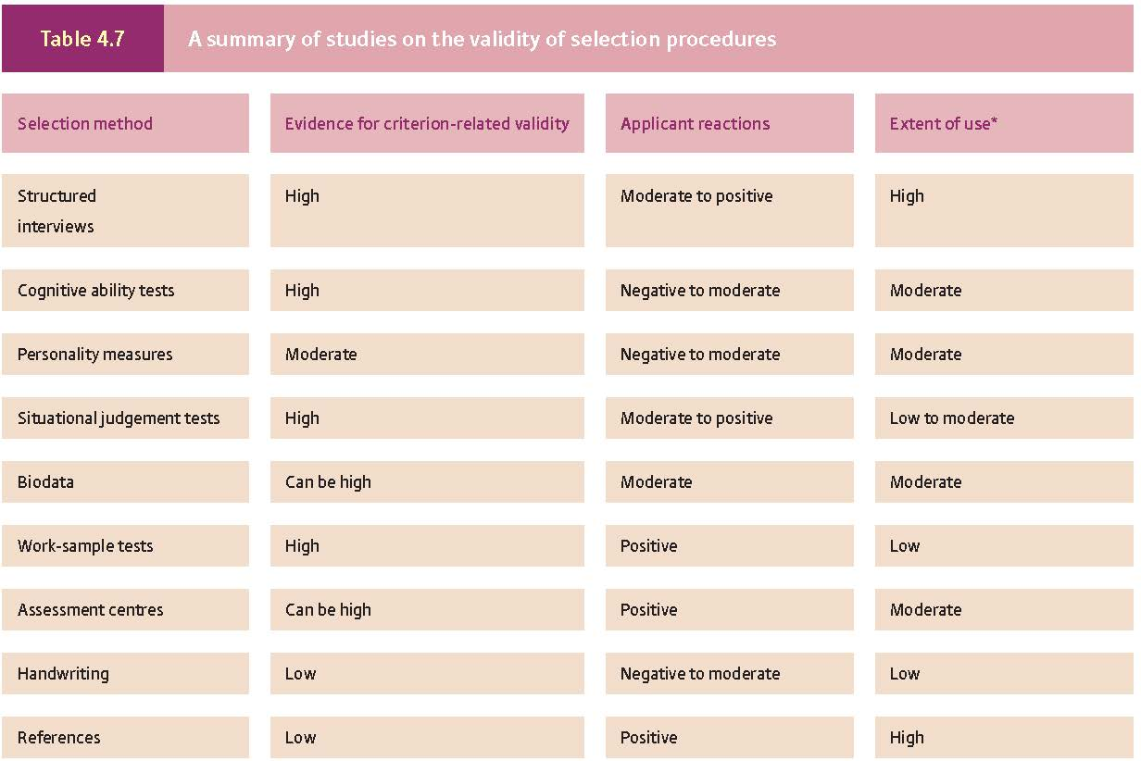

Slide 97
Table 4.7. A summary of studies on the validity of selection procedures
Selection method | Evidence for criterion-related validity | Applicant reactions | Extent of use*
Structured interviews | High | Moderate to positive | High
Cognitive ability tests | High | Negative to moderate | Moderate
Personality measures | Moderate | Negative to moderate | Moderate
Situational judgment tests | High | Moderate to positive | Low to moderate
Biodata | Can be high | Moderate | Moderate
Work-sample tests | High | Positive | Low
Assessment centres | Can be high | Positive | Moderate
Handwriting | Low | Negative to moderate | Low
References | Low | Positive | High
Notes:
Even if we had to use smaller font size ( in this case 18pt.) the final product is much better in terms of accessibility than the original one. We had A picture in jpeg. format. We had redesigned a table in word format.

Slide 98
Disability: Theoretical Prespectives…
Medical Model
Social Model
View of disability
A deficiency or abnormality
Cause of: a disability rooted in physical or psychological deficiency
Goal of change effort:
To diagnose, diminish, correct, and or accommodate perceived deficits
View of disability
A difference
Cause of: Ableism, lack of accessibility
Goal of change efforts:
To increase accessibility in all aspects of society and remove barriers that restrict life choices

Slide 99
Disability: Theoretical Prespectives..
Medical Model
Social Model
View of disability
A deficiency or abnormality
Cause of: a disability rooted in physical or psychological deficiency
Goal of change effort:
To diagnose, diminish, correct, and or accommodate perceived deficits
View of disability
A difference
Cause of: Ableism, lack of accessibility
Goal of change efforts:
To increase accessibility in all aspects of society and remove barriers that restrict life choices

Slide 100
2 more slides and adaptations
Remedying problems caused by the lack of ‘born accessible’ ….

Slide 101
Neglect definition
Acquired neuropsychological disorder of contralesional space awareness. Neglect is probably due to defective spatial attention orienting
Neglect patients are unable to detect, describe
verbally, or act towards contralesional spatial stimuli
Neglect is not due to elementary sensori-motor deficits (e.g., hemianopia, hemianesthesia, hemiplegia, etc.) or generalized mental confusion

Slide 102
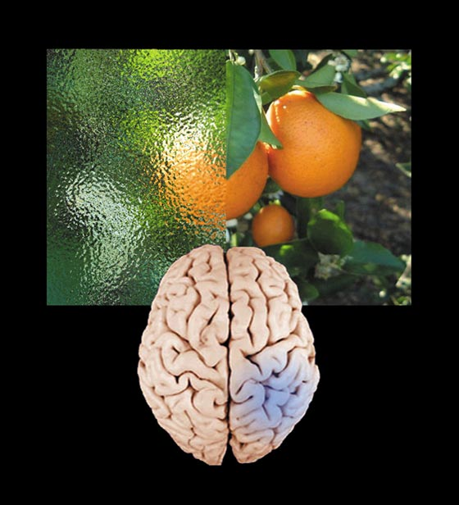
Interhemispheric asymmetries in neglect
Neglect is more:
- frequent
- long-lasting
- severe
- disabling...
…following lesions in the right hemisphere
Left neglect after right-hemisphere damage

Slide 103
Adaptations /corrections

Slide 104
Neglect definition
Acquired neuropsychological disorder of contralesional space awareness. Neglect is probably due to defective spatial attention orienting
Neglect patients are unable to detect, describe
verbally, or act towards contralesional spatial stimuli
Neglect is not due to elementary sensori-motor deficits (e.g., hemianopia, hemianesthesia, hemiplegia, etc.) or generalized mental confusion

Slide 106
Interhemispheric asymmetries in neglect
Neglect is more:
- frequent
- long-lasting
- severe
- disabling...
…following lesions in the right hemisphere
Left neglect after right-hemisphere damage

Slide 107
Here is the END
Let’s Remember that:
Creating Accessible Learning Environments = Inclusive teaching

Slide 108
We have an essential role to play in making
Courses Accessible
and creating a climate of equity and inclusion where all learners can participate successfully and develop.
Thank you for your participation!

