Slide 1
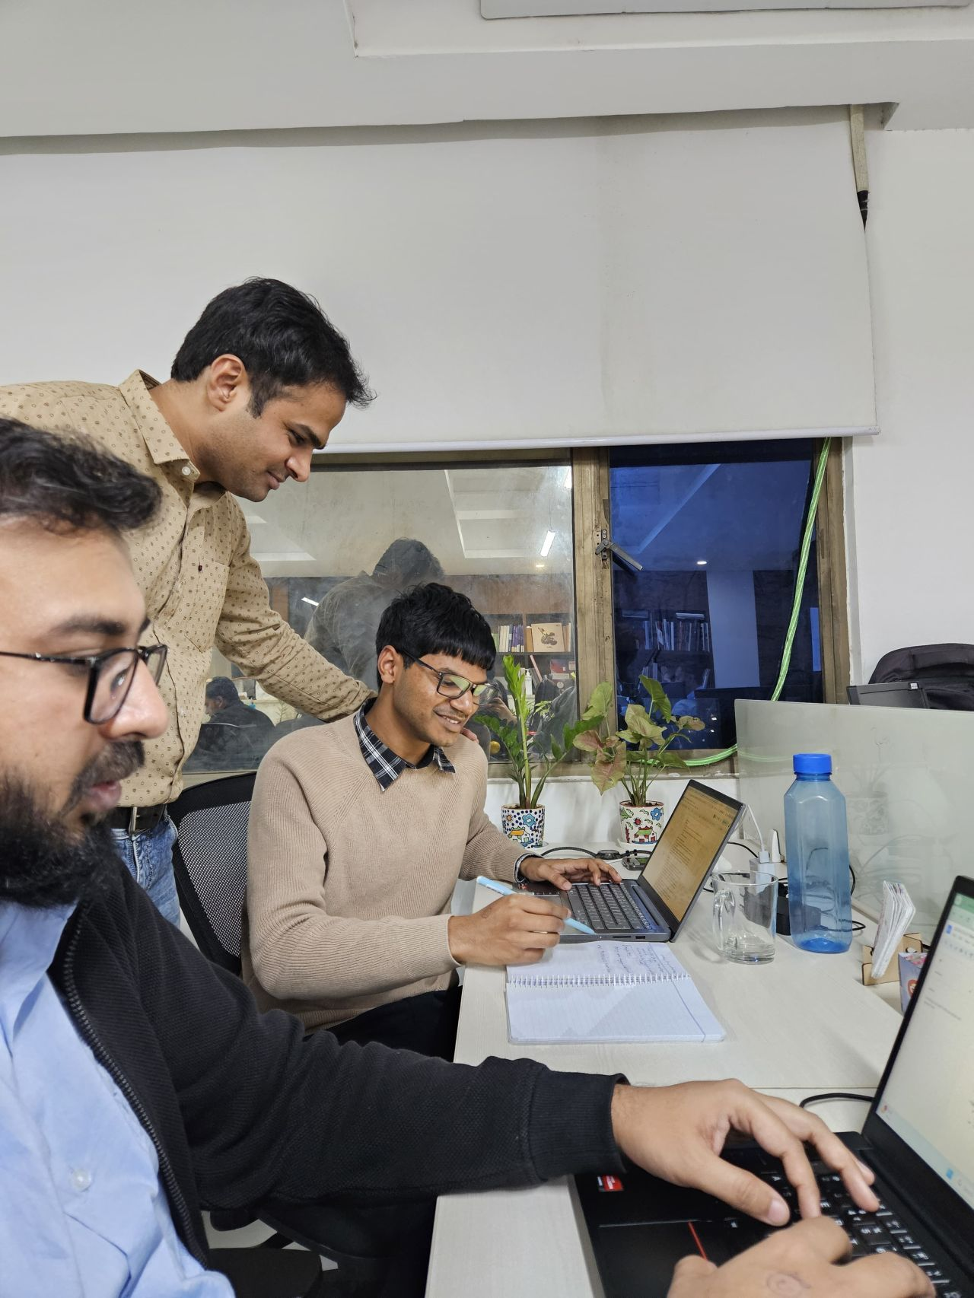
Young Professionals
in Development
Apply now for the next round!
September 2025 - February 2026

Slide 2
What is it?
‘Young Professionals in Development (YPD)’ is a high-level traineeship programme by the ICA World Foundation.
The programme aims to provide selected university students and recent graduates with practical experience on donor-funded projects in beneficiary countries in the Global South, implemented by one or more ICA World member organisations.
The YPD traineeship represents a transformative field experience for young professionals on their early career path in the field of international cooperation.
The first edition of the programme took place between February and July 2024, and we run two rounds per year. The first round of 2025 will begin in February till July, and we are now starting to plan for the second round, which will take place in the autumn.
Starting in September 2025 until February 2026 a new cohort of 5 to 10 outstanding young professionals will be enrolled in a 6-month traineeship programme.
This programme contributes to the implementation of the Sustainable Development Goals in different geographical areas and within various sectors of expertise.

Slide 3
YPD Objectives
1
CULTURE
Raise awareness of development cooperation among young people and foster a culture of sustainability and equality
2
EXPERIENCE
Offering unique opportunities for students and recent graduates to learn and gain hands-on experience working on donor-funded projects, ideally in developing countries.
3
PERSPECTIVES
Contribute to generating perspectives and creating employment opportunities for young people while fostering their personal and professional growth.
3

Slide 4
ICA World Foundation
Founded by IBF International Consulting in 2018, the ICA World Foundation brings together the members of ICA World – the International Consulting Alliance - to make a positive contribution to development. Our mission is to support the achievement of the UN Sustainable Development Goals and to create a lasting, long-term impact.
We aim to contribute to a more equitable, sustainable, and prosperous world by broadening perspectives from early years to later stages. To reach this goal we aim to undertake a series of activities, specifically linked to education, training, traineeships and awareness-raising. These are our core programmes:
Young Professionals Traineeship Program (YPD)
Volunteer Training Initiative (VTI)
Critical Thinking in Schools
Development Cooperation Awareness Raising
“Education is the passport to the future!”
www.icaworldfoundation.org

Slide 5
ICA World - the International Consulting Alliance is a unique network of 100+ independent member organisations and 50+ individual experts with clear technical or geographic specialisation, working on donor- funded projects in different beneficiary countries.
Since 2012, ICA World facilitates long-term cooperation between a growing network of trusted partners in development cooperation. The goal of the Alliance is to win together new projects, ensure high-quality project delivery and make a sustainable impact.
ICA World aims to:
• promote cooperation on donor-funded projects
• foster local ownership and technical expertise
• share knowledge, best practices and success stories
• contribute to positive and sustainable development
Networking for Development
www.icaworld.net

Slide 6
Young Professionals in Development
1
TRAINING
Early September 2025
2
EXPERIENCE
Sept 2025- Feb 2026
3
CONCLUSION
End of Feb 2026
A few days of virtual induction trainings aimed at providing trainees with some basic knowledge about the development cooperation sector.
(Field) experience on projects implemented by one or more ICA members.
YPD experience comes to an end.
Final online gathering to share experiences, best practices and lessons learned by the trainees.
A mid-term meeting to exchange on experiences & ask training-related questions.
An individual coaching session for future career advice will be offered.
5

Slide 7
Young Professionals in Development
The programme covers all costs of the traineeship (travel, accommodation, other living expenses),
and is financed through different funding schemes:
The EU’s Erasmus + Traineeship programme
Municipal and regional scholarships for young graduates
Budgets of the projects (whenever possible)
Donations from ICA members, partners and other sponsors
6

Slide 8
Who can apply?
Eligibility Criteria
The YPD Traineeship Programme is open to final year undergraduate students, Master’s students, and upcoming graduates.
Background in international relations, development studies, development economics, or similar.
Excellent command of English, other languages are an asset.
French/Spanish is required for francophone/hispanophone areas.
Selection Criteria
You have proven interest or experience in development aid projects and/or international affairs.
You are service-minded, pro-active and outgoing and have excellent communication, interpersonal and organisation skills.
Strong IT skills are required (MS Excel and MS Word proficiency.
Additional digital and marketing skills will be considered an asset.
The Sustainable Development Goals are a universal call to action to end poverty, protect the planet, and ensure a sustainable future for all.

Slide 9
YPD Selection Process
The selection for the traineeship positions available at the YPD joint Traineeship Programme is carried out on a rolling basis (first come, first serve), based on applications received during the competitive call. The process involves evaluating candidates’ qualifications, skills and motivation.
TIMELINE
March – Early May
Call for Applications
First assessment and interviews with
preselected candidates
April-June
Selection of candidates and 2nd round of interviews with potential host organisations
April-July
Securing adequate funding
(in cooperation with the selected trainees)
June - August
Preparation for departure (flights, accommodation, visa etc.)
Shortlisted candidates will be contacted by the selection team for a preliminary interview.
September- February
Traineeship
8

Slide 10
Young Professionals in Development
The YPD trainees will be selected through a competitive Call for the Traineeship Applications.
Deadline: 28 April 2025
Those interested in the YPD Traineeship Programme can apply by sending the completed application form and a detailed CV, in English, to the following email address:
info@icaworldfoundation.org
Apply to the YPD Traineeship Programme and Good Luck!
9

